Slide 1
ICS Group 06 ThinkFood

Slide 2
Team member
Jonghyun Choi (James)
Rolando Pacho
Quang Pham
Changsin Park
Qi Li (Murphy)

Slide 3
Group roles
Week | Changsin | Murphy | Rolando | Quang | James
02 | DBA/Back-end | Front-end | Middle-ware | Front-end | Team leader Technical writer
03 | DBA/Back-end | Team leader Front-end | Middle-ware | Front-end | Technical writer DBA/Back-end
04 | Front-end | DBA/Back-end | Team leader Front-end | Middle-ware | Technical writer DBA/Back-end
05 | Team leader Middle-ware | DBA/Back-end | Technical writer Front-end | Front-end | Middle-ware
06 | DBA/Back-end | DBA/Back-end | Front-end | Team leader Front-end | Middle-ware
07 | Front-end | Middle-ware | DBA/Back-end | DBA/Back-end | Team leader Front-end
08 | Middle-ware | Front-end | Front-end | Team leader | Technical writer

Slide 4
Project overview
ThinkFood is a web application where customers can order foods online instead of googling each restaurant to find their favorite food.
Customer: see menu of different categories, make purchase, view order history, write review for specific food, etc
Administrator: Add/remove restaurant and restaurant’s menu
Restaurant: Receive orders from administrator

Slide 5
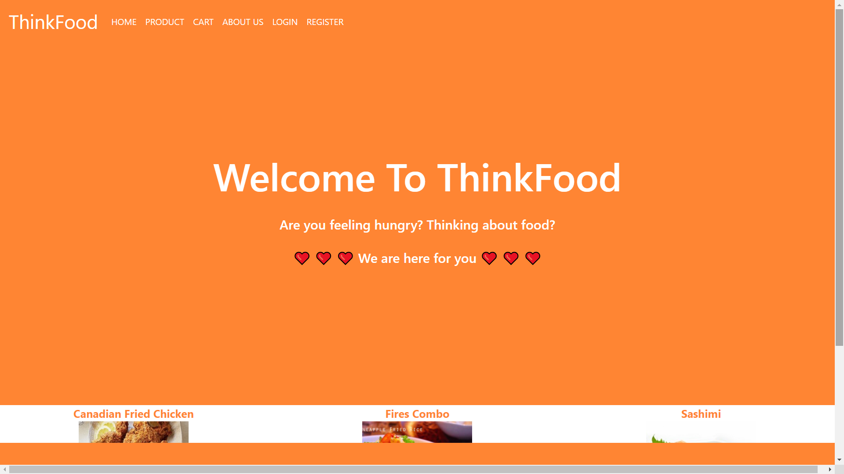
DEMO

Slide 6
Problems and challenges
 | Problems | Solution
Managing task on schedule | Delayed tasks, missing tasks, new tasks | Modified the priorities of some task and changed the schedule
Standards | Did not define rules on filename, variable, table and column | Defined the base file for standard and tried to follow the names in those documents
GitLab | Lost some code files and faced conflict files between GitLab master branch and deepblue server | Learned how to use GitLab and practiced some bash commands for Git like pull, fetch, merch, add, etc…
Analyzing requirement | Did not figure out all of the requirements | Check for missing requirements at the beginning of the class so we could make proper action on time

Slide 7
Skills learnt
Co-operation
Create a meeting every week to check the project’s progress
Using Slack for quick communication
Team work spirit
GitLab
Managed our sources consistent

Slide 8
Skills learnt
MySQL and Workbench
Learnt how to use MySQL and Workbench to create database and connect it to website
HTML, PHP, CSS
Had chance to experiment what we learnt before in ics111, ics112 and ics199
Review HTML, CSS, PHP, Bootstrap, JavaScript, JQuery

Slide 9
Proposed changes
Time management
Focus on assigning resources and tasked based on the priority with enough time, in case some tasks might be delayed by technical issues and changement
Dedicated role assign
Had some difficulties on switching roles every week. It is good for practice but it was time consuming to explain one’s code or logic to other team member

Slide 10
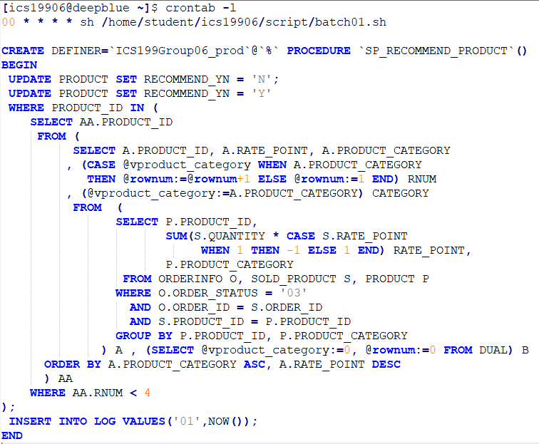
Code snippets
Batch for recommend products

Slide 11
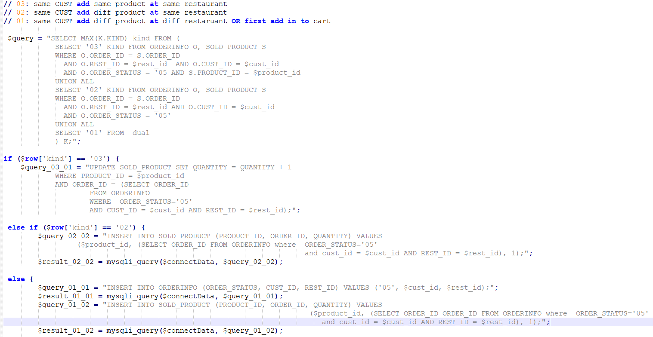
Code snippets
Add products to cart

Slide 12

THE END

